Slide 1
Preparing for the Verdict: Pre-Trial Research and Focus Groups
Yvette Young & Nathan Crane

Slide 2
Juror Decision Making: The Art & Science (I)
Prior to the 1950s, rigorous studies of juries and decision making were few and far between.
In the 1950s, the first systematic study of juror decision making occurred at the University of Chicago.
Chicago Jury Project involved assessing 3,576 criminal jury trials and 4,000 civil jury trial.
Advent of mock trials to conduct juror research.
Recording of five jury trials in Wichita, Kansas lead to special hearings before the Senate Judiciary Committee in 1955.
Direct observation/recording was censured by ABA/USAGO.
From the 1980s to the 2000s, research on juries has continued “at a blistering pace on a wide and ever-expanding range of topics,” including research by multidisciplinary teams.
Source: Dennis J. Devine, Jury Decision Making: The State of the Science (2012)

Slide 3
Juror Decision Making: The Art & Science (II)
Cognitive Bias:
Confirmation Bias;
Hindsight Bias;
Self-Serving Bias;
False Consensus Bias
Social Bias / Cultural Norms / Values
Heuristics and Information Process Strategies:
Representativeness
Availability
Anchoring
Source: Carol B. Anderson, Inside Jurors’ Minds: The Hierarchy of Juror Decision-Making, A Primer on the Psychology of Persuasion (Nat’l Inst. Trial Advocacy 2012)

Slide 4
Juror Decision Making: The Art & Science (III)
Devine’s Integrative Multi-Level Theory of Jury Decision Making
“Individual Differences Matter”
“Jurors Use Relevant Information Regardless of Its Source”
“Jurors Do Not Keep Things Separate”
“Jurors Create Stories”
“Deliberation Is Not a Democracy”
“Majority Factions Are Usually Successful”
“Local Majorities Can Be Important”
Individual – “Director’s Cut Model”
Collective – “Story Sampling Model”
What can be done prior to trial to predict processing and responsiveness to facts, arguments, and themes?

Slide 5
Social Science Approach to Analyzing Data
For every question we have about society we want to use data to understand patterns and anomalies
Primary goal is to use rigorous and systematic methods of data collection and analysis.
Get creative about what you consider as data
My preference: mixed methods
Multiple types of data
Triangulate the issues

Slide 6
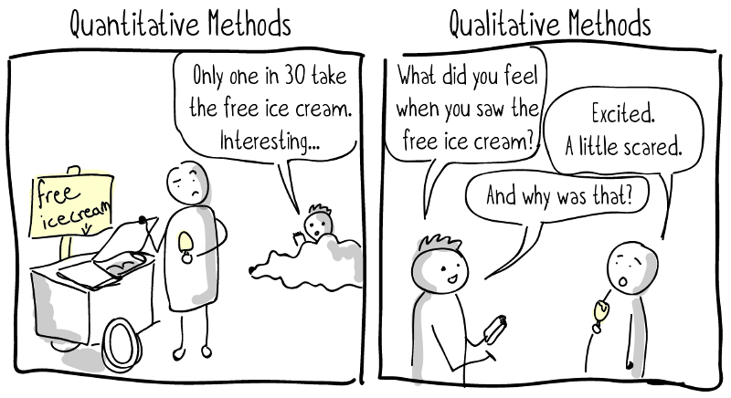
Preparing for Trial
Using data effectively for
Jury selection
Preparing arguments
Two sides of the same issue: is there a pattern to how jurors respond to arguments
Do groups of people cluster together in their responses
If groups cluster together, why?

Slide 7
Social Science Research
Previously collected data: social surveys
Demographic associations with relevant issues
Sources: Gallup Polls, Pew Research, General Social Survey
Notes:
Advantages:
Large representative sample
Reliable and valid survey questions
Disadvantages:
Questions may not target the issues you are seeking to understand
General, rather than specific

Slide 8
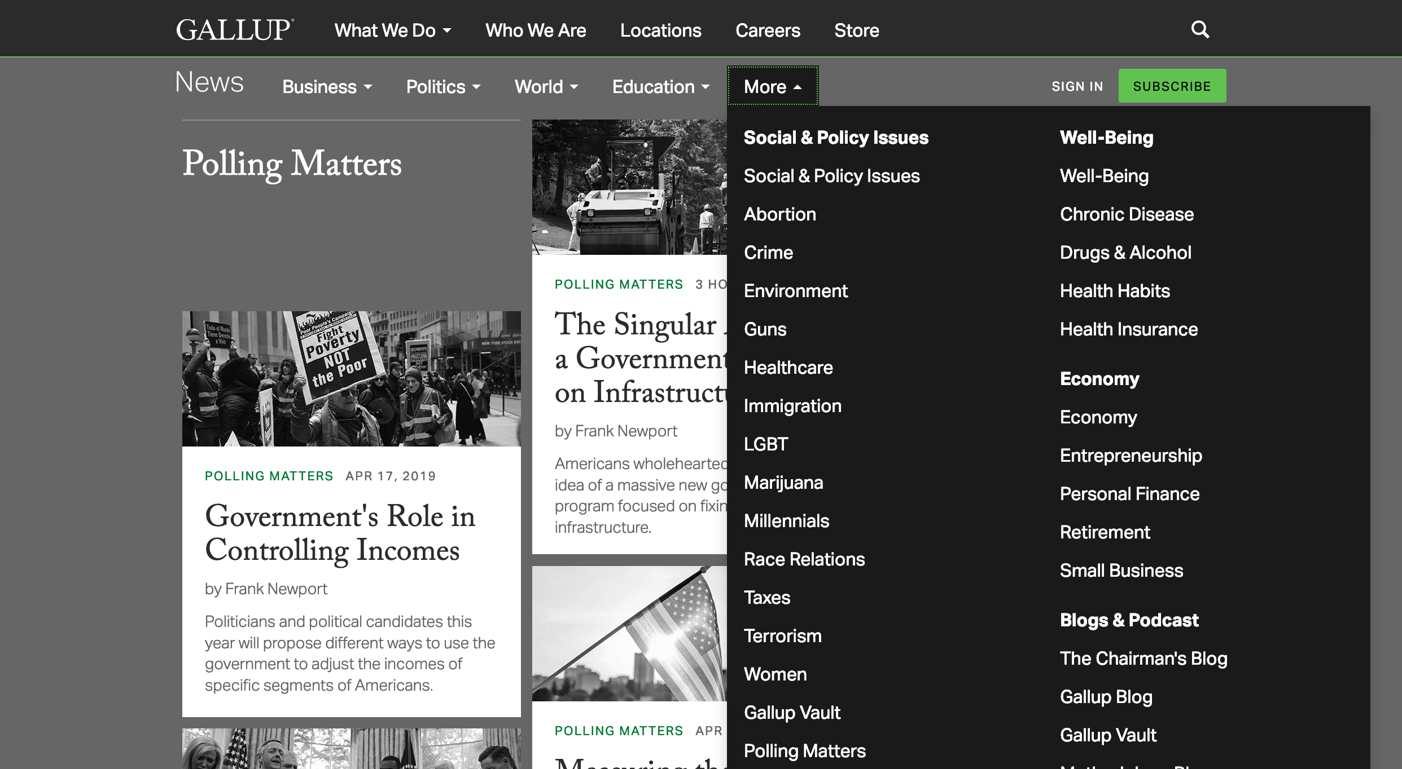
Social Science Research
Previously collected data: social surveys

Slide 9
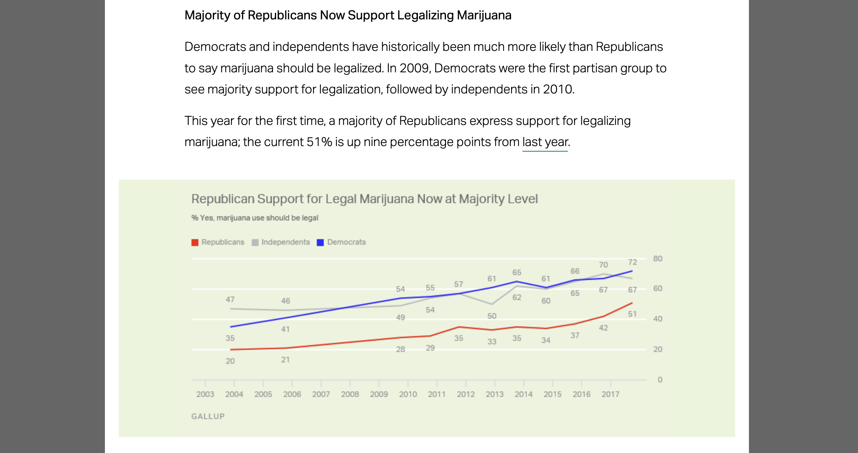
Social Science Research
Previously collected data: social surveys

Slide 10
Social Science Research
Previously collected data: social surveys

Slide 11
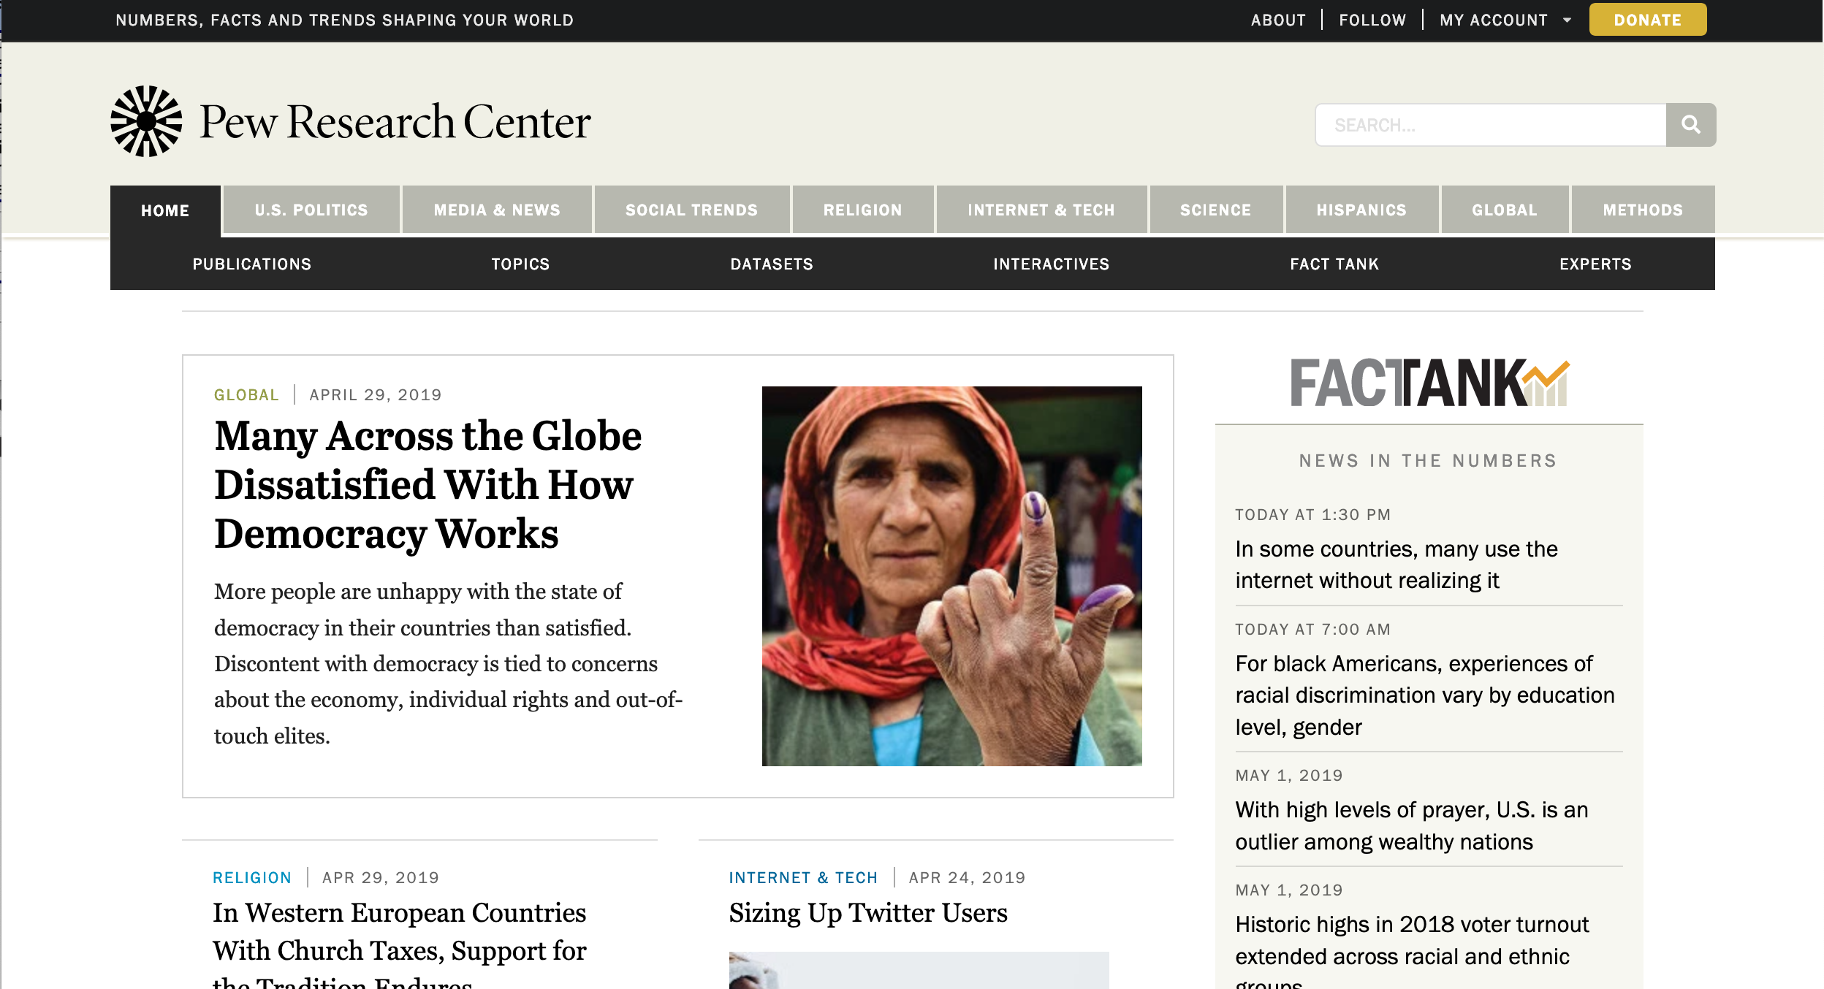
Social Science Research
Previously collected data: social surveys

Slide 12
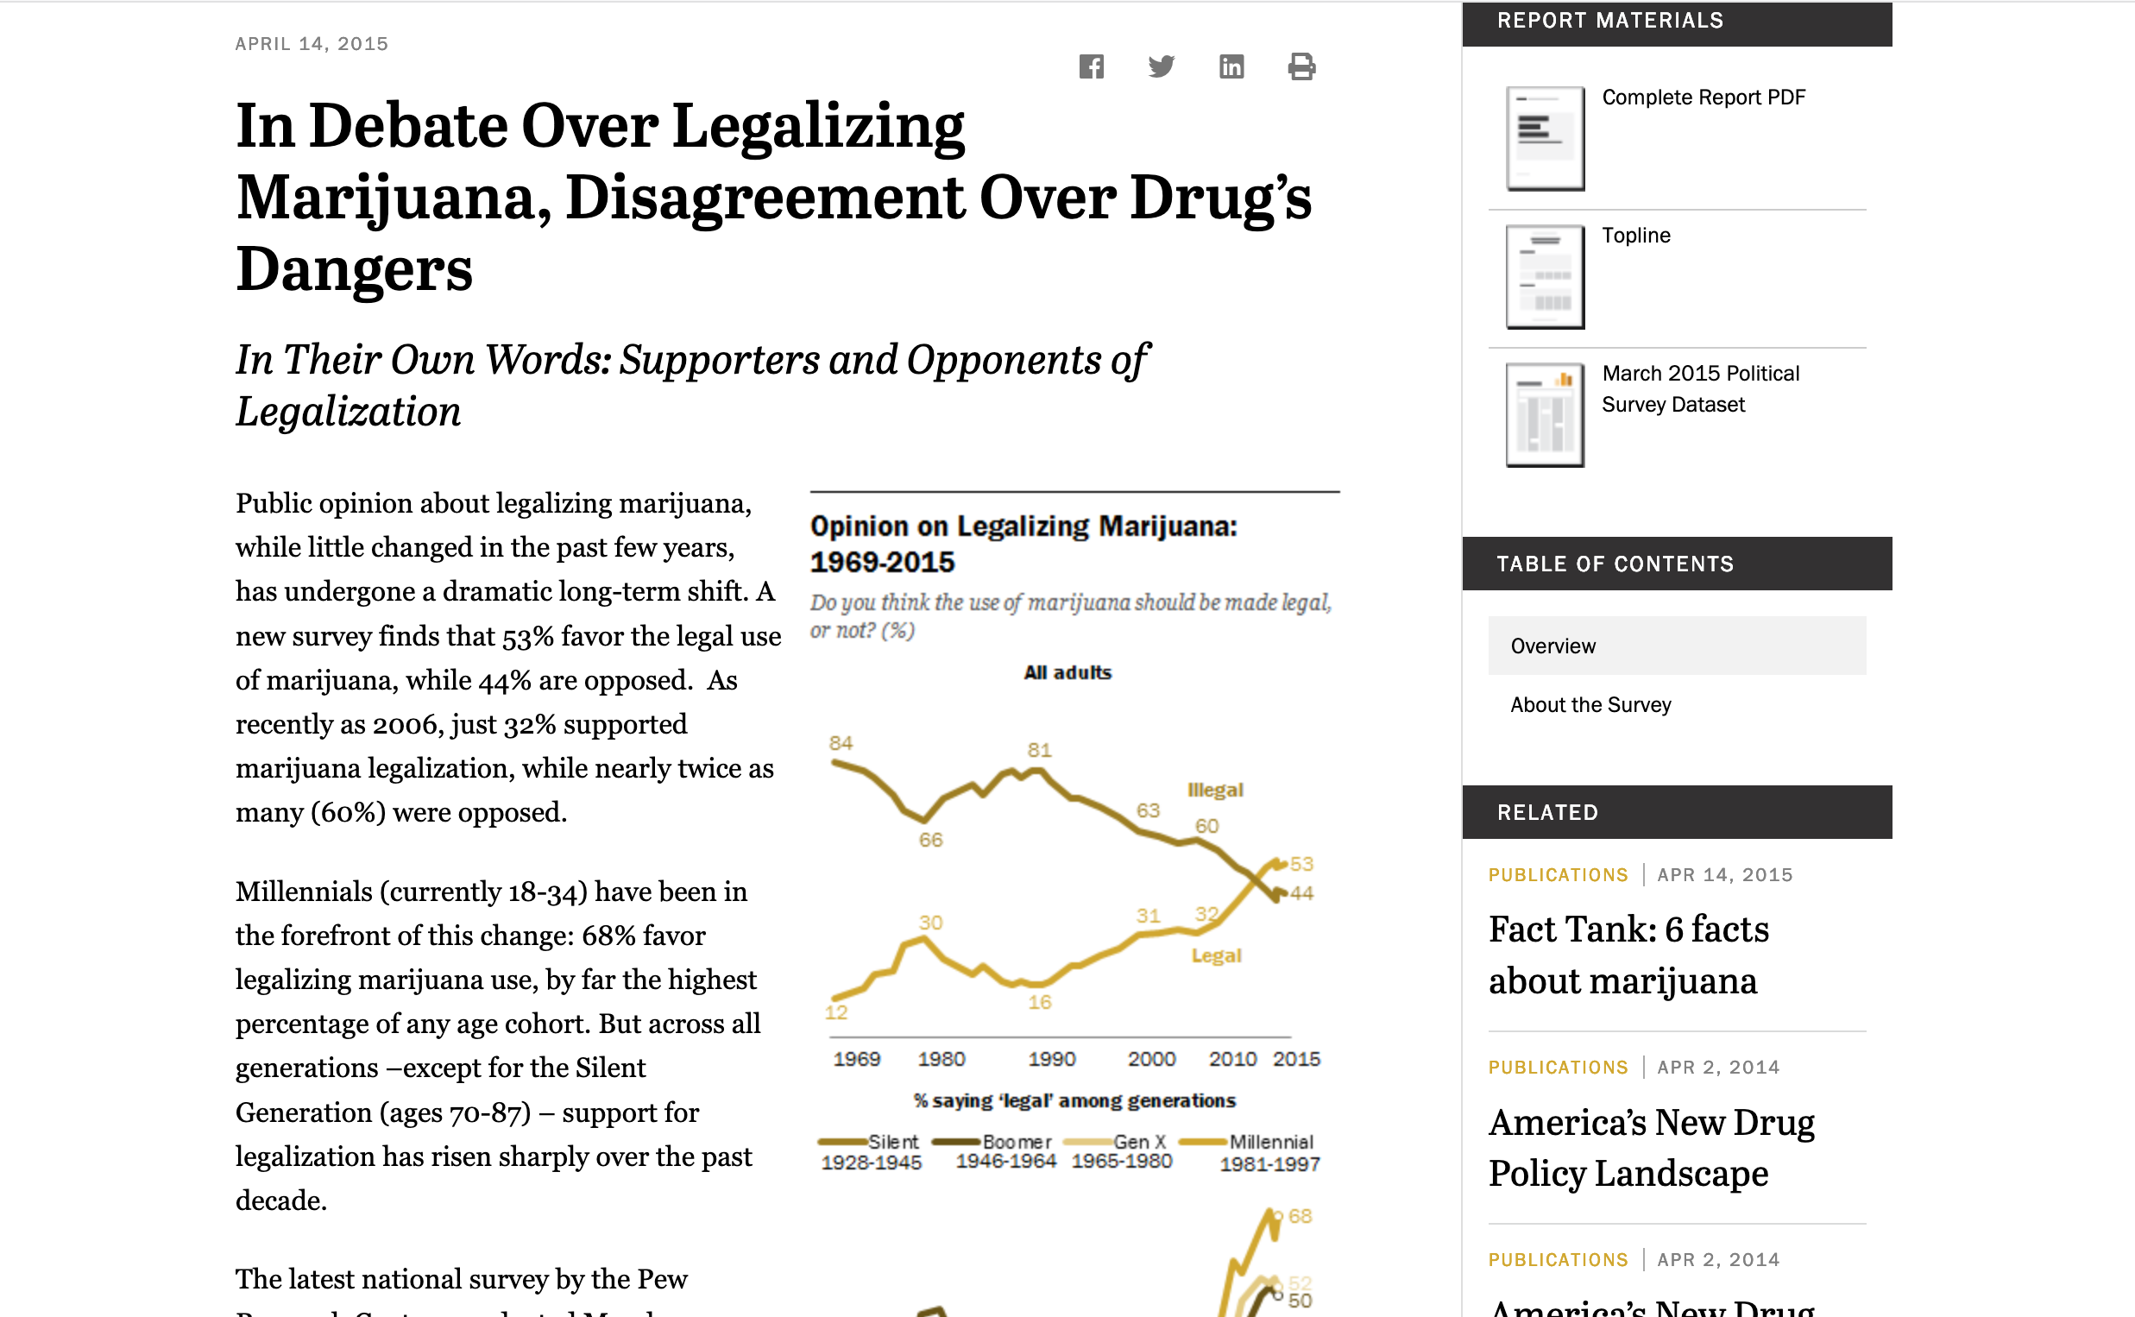
Social Science Research
Previously collected data: social surveys

Slide 13
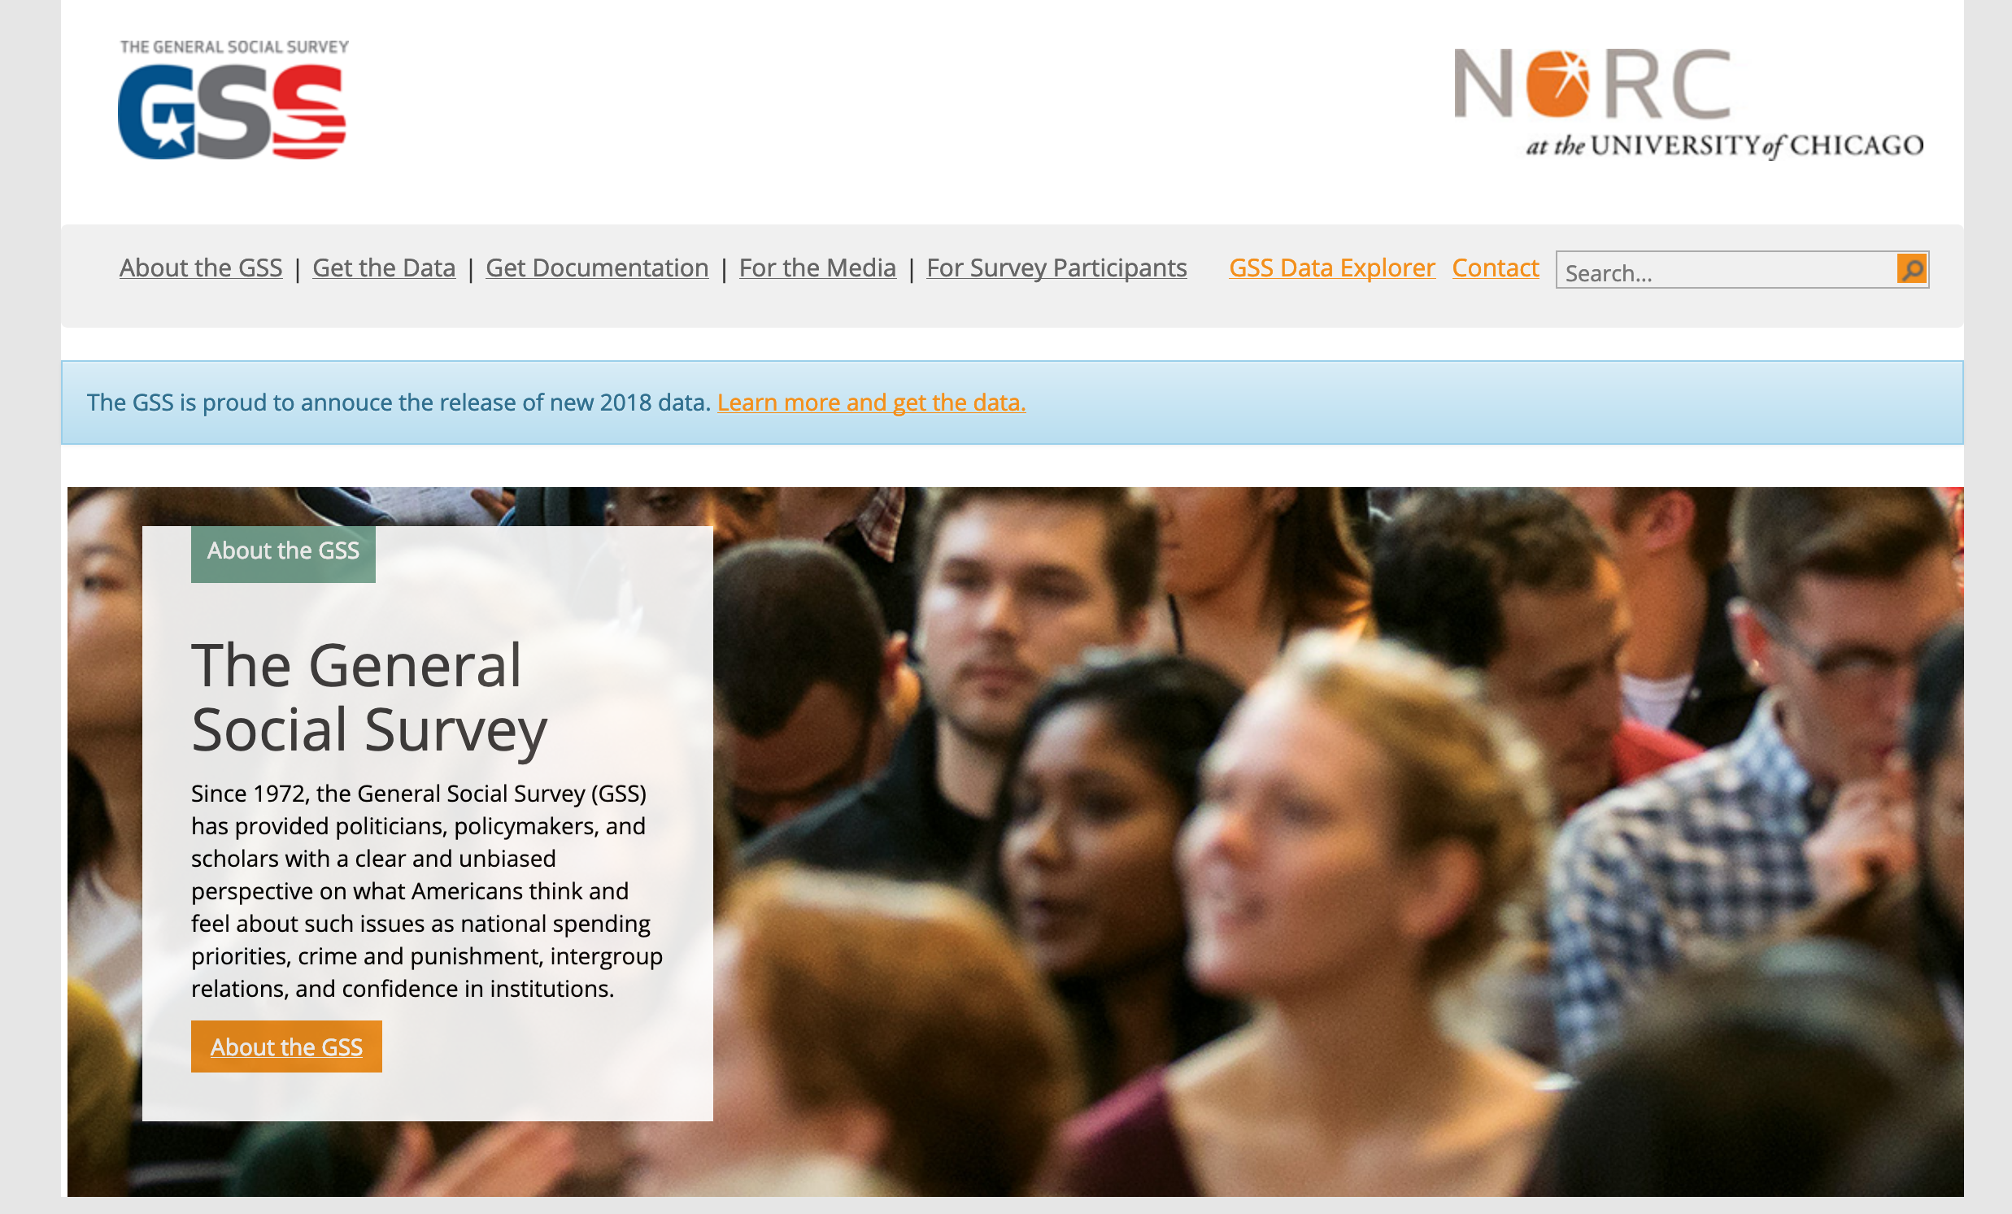
Social Science Research
Previously collected data: social surveys

Slide 14
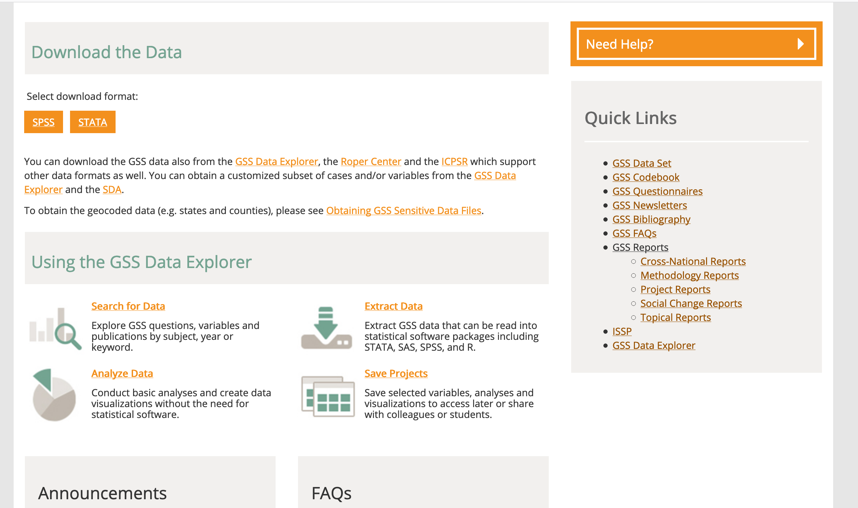
Social Science Research
Previously collected data: social surveys
Notes:
Previously collected data: social surveys
Demographic associations with relevant issues
Sources: General Social Survey, Pew Research, Gallup Polls
Advantages:
Large representative sample
Reliable and valid survey questions
Disadvantages:
Questions may not target the issues you are seeking to understand
General, rather than specific
Original data collection:
Surveys
Focus group interviews
Simulations

Slide 15
Social Science Research
Original data collection:
Surveys
Focus groups
Simulations

Slide 16
Social Science Research
Participant selection:
Representative sample
Mirror the characteristics of the actual jury

Slide 17
Selecting surrogate jurors
Identify your population from which your jury will be drawn.
Summarize the characteristics of that population.
Include all relevant factors for which you have information.
Age
Gender
Race/ethnicity
Education
Income
Be precise (combined categories, rather than the individual percentages)

Slide 18
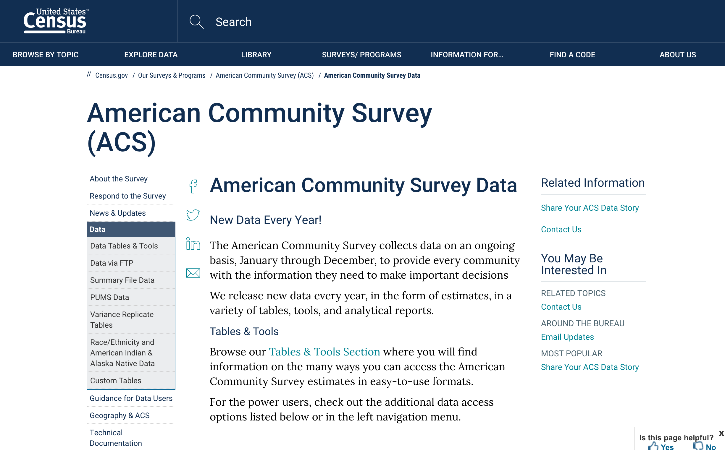
Selecting surrogate jurors
Census data, ACS
https://www.census.gov/programs-surveys/acs/data.html

Slide 19
Selecting surrogate jurors

Slide 20
Selecting surrogate jurors
Recruit participants
What size will your jury be?
How many applicants will you need to fill focus groups of that size?
Draw from your applicant pool
Use random selection processes
Compile a list of backup participants

Slide 21
Collect Data
1
Extensive Intake Survey
2
Presentation of Argument
3
Short Post-presentation Survey
4
Focus Group Deliberation
5
Final Survey
Notes:
Survey your surrogate jurors
Statistical analysis of data
Are there patterns/relationships?
Conduct focus groups
Thematic analysis of data
Why are those patterns/relations present?
Mixed methods
Explain patterns in the data
Identify new themes that warrant statistical analysis

Slide 22
Collect Data
Survey Design Considerations
Question Order
Question Wording
Clarity
Residential location_______________________
vs.
In what city or town do you live?

Slide 23
Collect Data
Survey Design Considerations
Question Order
Question Wording
Clarity
Leading questions
Bad Question: How short was Napoleon?
The word “short” immediately brings images to the mind of the respondent. If the question is rewritten to be neutral-sounding, it can eliminate the leading bias.
Good Question: How would you describe Napoleon’s height?

Slide 24
Collect Data
Survey Design Considerations
Question Order
Question Wording
Clarity
Leading questions
Double-barreled
Questions
If a situation like Vietnam were to develop in another part of the world would you support sending U.S. troops?
18% supported
When the phrase “to stop a communist takeover” was added to the end of the question, 33% supported.

Slide 25
Collect Data
Survey Design Considerations
Question Order
Question Wording
Clarity
Leading questions
Double-barreled
Questions
Two-ways to get good questions
Test the questions on non-participants
Use questions tested by other researchers

Slide 26
Collect data
Focus groups as simulations
Focus group design
Discover themes
Comparative presentations or groups
Notes:
Focus group design
Discover themes
Multiple focus groups receiving same content
Identify themes arising in each group
Saturation
Comparative presentations or groups
Experimental design
Alter some component of the focus group
Different participant composition
Different presentations
Compare the results

Slide 27
Data analysis
Survey data
Issues: small sample size
Solution: purposive selection of participants to match population characteristics
Look at the strength of associations rather than statistical significance
Focus group data
Issues: reliability of qualitative data
Solution: systematic analysis of recordings and transcripts
Reliability: repeated thematic coding (multiple analysts)
Systematic analysis of themes: how often do they arise, how many independent participants raise the theme, etc.
Look for connections and explanations

Slide 28
Predicting Juror Reactions
Supplement your formal data with publicly available data
Social media
Personal websites
Group memberships
Use to help you understand unexpected patterns in the data
Use to identify membership groups that you didn’t anticipate

Slide 29
Main Takeaways
Collect and analyze your data in a systematic manner
Best practices:
Use Census data to select your participants
Conduct multiple focus groups
Combine quantitative and qualitative data

Slide 31
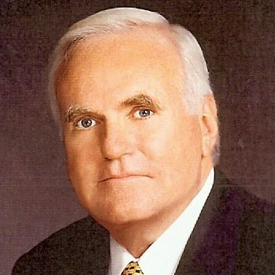
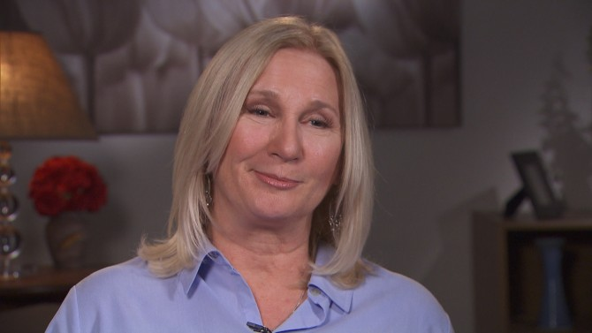
Focus Groups
Jo-Ellen Dimitrius
Jury consultant for the defense.
Donald Vinson, Ph.D
Jury consultant for the prosecution

Slide 32
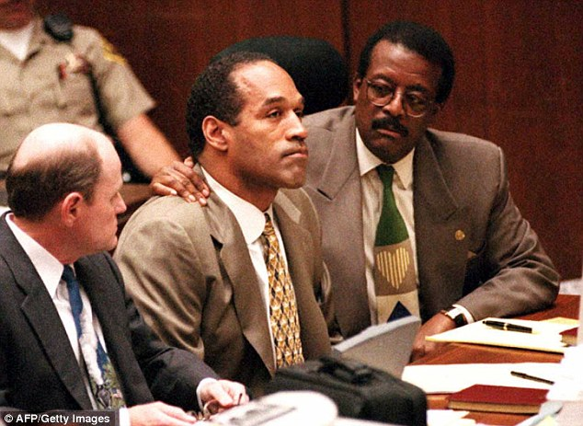
Focus Groups
Ideal juror:
“a female African-American with high school education or less.”

Slide 33
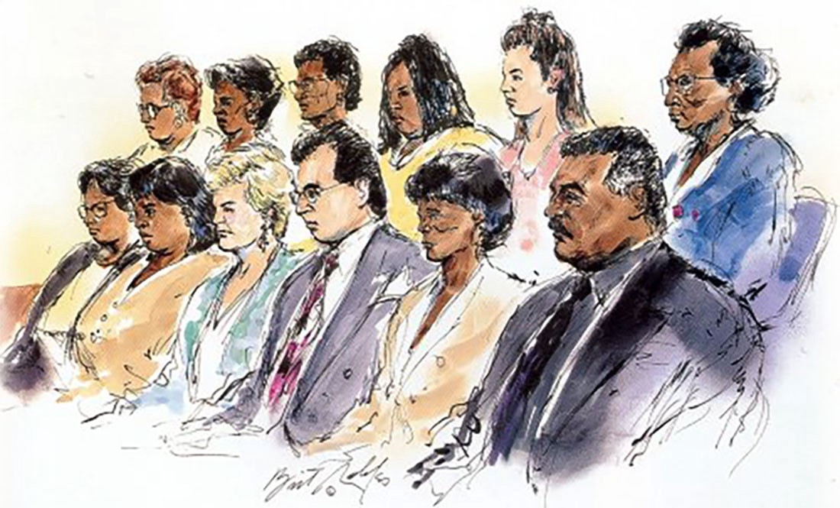
Focus Groups

Slide 35
Wrong Reasons For Not Doing a Focus Group
Focus groups are too expensive.
I have tried many cases in this jurisdiction. The juries love me!
I have been doing this for years.
My cases always settle.
I know my case better than anyone.
Thinking that certain evidence will never come in.
My experts have us covered.

