Slide 1

Transforming Your Practice
Leaping Canyons One Step At A Time
Henry M. Sneath
Houston Harbaugh, P.C.
Pittsburgh, Pennsylvania
412-288-4013 or www.hh-law.com

Slide 2
Trial Lawyer
“The wisdom of our sages and the blood of our heroes have been devoted to the attainment of trial by jury. It should be the creed of our political faith.”
-Thomas Jefferson, First Inaugural Address 1801

Slide 3
Planning
"I used to say that, as Solicitor General, I made three arguments of every case. First came the one that I planned--as I thought, logical, coherent, complete. Second was the one actually presented--interrupted, incoherent, disjointed, disappointing. The third was the utterly devastating argument that I thought of after going to bed that night."
-Robert H. Jackson, Advocacy Before the Supreme Court (1951)

Slide 4
Execution
“Things may come to those who wait, but only the things left by those who hustle.”
-Abraham Lincoln

Slide 5
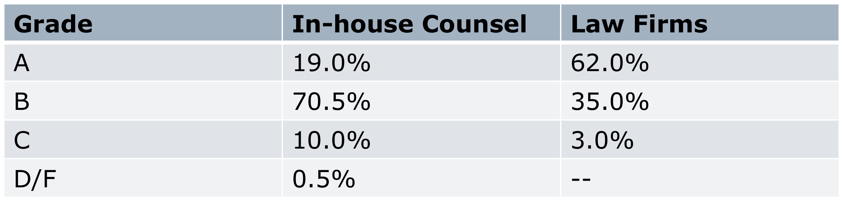
The Disconnect…
Source: Inside Counsel’s 18th Annual Survey. n = 862 in-house counsel, 135 lawyers at law firms
Notes:
5

Slide 6
Our Environment
Unprecedented level of competition
Time-tested strategies now obsolete
Changing landscape of our industry:
  Boutiques?
  Regional firms?
  Global mega-firms?
Hourly rates > $1,000?
Gen X/Y “work-life balance”
Notes:
6

Slide 7
More Sophisticated Clients
“Convergence”/Consolidation
RFP’s
Purchasing agents
  Procter & Gamble
Resistance to paying for junior associates
  Bank of America
Emphasis on diversity
  Wal-Mart
Notes:
7

Slide 8
Billing Model Under Stress
Hourly billing is based on cost of production not value to client
How many hours does a stunning insight take?
E-billing data analysis tools can enforce compliance with protocols
Human analysis of bills can do even better:
  $2-million/year to save $30-million/year
Notes:
8

Slide 9
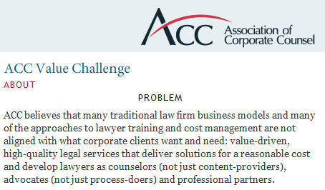
The ACC’s “Value Challenge”
Notes:
9

Slide 10
Small to Medium Sized Firm Perspective: Competition Skills
What skills do we need to protect our territory?
Does our firm need to redefine itself to better address the needs of the marketplace?
What are big firms doing to streamline their services, and therefore their ability to get and keep clients?
Which of those will work for us?

Slide 11
Small to Medium Sized Firm Perspective: Business/Management
How sustainable is the traditional partnership structure in the new competitive environment?
Where do we get the capital to grow?
How well trained in management are our leaders?
Are our marketing professionals really professional – or just party planners?

Slide 12
Law Firm Self Evaluation
How does your firm address these questions?
  What business are we really in, anyway?
  Do we have a strategic plan to accomplish our goals?
  What is our firm culture?
  Are we properly investing in our firms future?
  How can we become more profitable?
  Do we need to grow, and if so why and how?

Slide 13
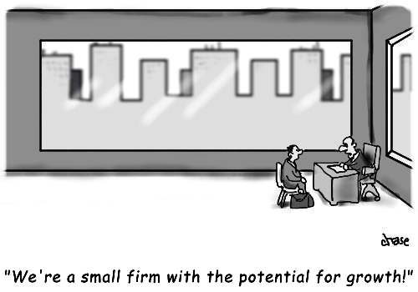

Slide 14
Execution
There is no one successful model;
Firms that achieve higher levels of partner income are simply executing better within the framework of the law firm business model

Slide 15
Litigation in Utah
Here’s where the audience helps!
  Tell me about Utah litigation
  Which have affected your firms practice?
    Tort reform;
    Increase in insurance captive firm counsel;
    Law firm mergers and consolidation;
    Client company mergers;
    Economy?
    Audits

Slide 16
Client
Audits and
Reductions
Litigation
Restrictions
Low
Billing
Rates
Non-
Challenging
Work

Slide 17
What Do You Want?
More of something you are already doing in part?
Something completely new?
Increase billable rate?
Less volume?
More sophisticated matters?
Make more money?

Slide 18
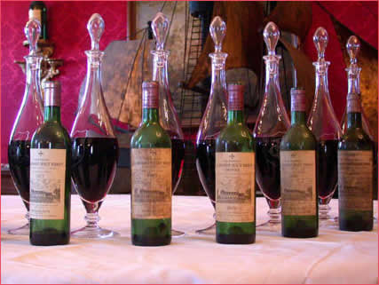
When is it Time?
Can you find it in your existing firm?
Is your career trajectory flat?
Is quality of life and certainty keeping you where you are?
Are you in a position to accept some uncertainty?

Slide 19
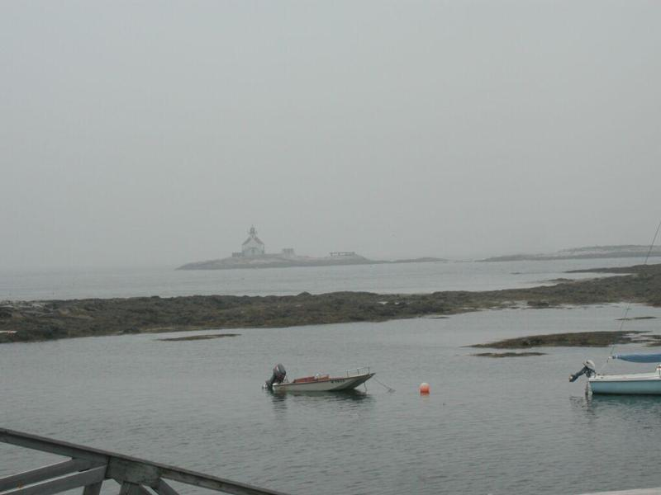
Price Of Change
Willing to make adjustments;
Billable hours may go down;
Realize that income may go down in short term;
Will firm support these changes;
Do you need to look elsewhere?

Slide 20
Sell Your Strengths
Good billing habits;
Extensive trial experience;
Great client contact;
Public speaking experience;
Understand ADR;
Understand Insurance;
You can see the end game;
Litigation management;
Not afraid to analyze a case early and to set a budget;

Slide 21
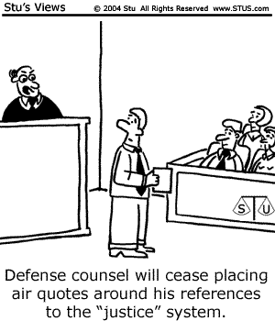

Slide 22
Strategy Means Saying No
“I never saw a dollar of revenue I didn’t like”—wrong answer.
Organize your firm:
  Geographically: Where is the work you’re best at?
  By practice group: What do we do best and how can we get more of us doing it?
  By client/industry: Insurance companies, biotech/healthcare, aviation, media/publishing
Notes:
22

Slide 23
Strategic Plan - Practical
Education;
Make target list of existing clients;
Coverage work and direct claims as opposed to defense work;
Business claims under policies versus bodily injury or property damage;
Make target list of potential clients

Slide 24
Existing Clients - Insurers
Coverage opinions;
Bad faith claims;
Unfair trade practices claims;
Agent and broker claims;
Declaratory Judgment actions;
Commercial disputes with agencies and brokerage firms

Slide 25
Life, Health & Disability
Contract claims;
Bad Faith;
Agent and sales practices claims;
ERISA;
Disability claims;
Denial of death benefit claims;

Slide 26
Commercial Liability:
Coverage Part B Claims
Advertising Injury
  Misappropriation of advertising ideas or style of doing business;
  Slander/libel/invasion of privacy
  Copyright, trade dress infringement
Personal Injury
  Libel/Slander
  False Imprisonment
  Malicious prosecution

Slide 27
High End Torts and Claims
Products liability (often self-insured);
Construction claims;
Employment claims and suits*;
Toxic and environmental;
D&O and E&O claims
Business Torts

Slide 28
Typical Federal Court Case Docket – Commercial Cases
  116 Insurance Contract
  112 Other Contract
  251 Employment Civil Rights
  165 Other Civil Rights
  104 ERISA
  17 Fraud/ Truth in Lending
  3 RICO
  8 FMLA
  31 Consumer Credit
  12 Securities
  3 Environmental
  188 Social Security
  12 Patent
  19 Trademark
  10 Copyright
  _________________
  1051 Total Commercial

Slide 29
Typical Federal Court Torts Docket
288* Products Liability
65* PI Pharma
88 Other PI
8 Personal Property Damage
3 Personal Prop Damage Products
2 Assaults/Libel
79 Motor Vehicle
6 Motor Vehicle Products
17 Med Mal
8 Torts to Land
1 Marine Products Liab.
_________________
565* Total Tort
*200 -250 Reality

Slide 30
UTAH – 2018 & 2019
80 Patent and Trademark Cases filed;
How many did you get?
On How many were you local counsel?
  To a big national firm that thinks that $450/hr. is too low;
    Makes them look bad;
They need someone on team that knows the judge and local practice customs;
Do you have a web page for “local counsel”?

Slide 31
Essential Tools
Detailed CV
Trial experience listed specifically
Membership and leadership in trade and industry groups
Network of friends and attorneys Bigger = Better
Firm website – as destination
Linking Sites on internet
Video and Social Media Coordination

Slide 32
Easy Changes - Organizations
Drop Tort Section of ABA for IP
Join DRI Commercial Litigation committee – along with Insurance
Local and State Bar – different sections
Find and work towards leadership (eg: Editor) positions in organizations
Build contact lists in each group
  Microsoft Office contacts – use “category” function

Slide 33
Easy Changes - Personal
Rework the bio and CV – have picture
Prepare to answer the “what kind of work do you do” question with more attention to “what you would like to do”
Build a database of information:
  Websites
  Publications
  Web linking services

Slide 34
Tougher Changes
Leave your firm?
Cold Turkey by referring work?
Parallel Tracks
  Run-off commodity work
  Reassign work to younger lawyers
  Keep some work that will get you into court/trials
Ask existing clients for different work
  Introductions to other departments

Slide 35
Toughest Changes
Resolve to lose your biggest client
Billable hours may slip for a while – maybe for good
Possible tension with partners as hours go down and rate goes up
Realize that time with old clients may be unproductive
Travel time – away from home time – should increase

Slide 36
Your Firm’s Brand
“A brand is a promise.” Of:
  Consistency
    Of approach;
    In all marketing and communication materials;
    Above all, of the firm’s culture as embodied by every one of its lawyers
    And:
Notes:
36

Slide 37
  Reliability
    No surprises;
    Great Billing Practices;
    Cost Effective Work;
    Active, not passive, communication
      Even if “nothing’s going on”

Slide 38
Succession Planning
Start early;
Generational – mix it up;
Diversity;
Teach and reward marketing;
Share origination (Don’t punish transition of clients)

Slide 39

Websites
Design and links
Hosting and Linking
  Thomson-West “Findlaw.com”
  Martindale-Hubbell “Lawyers.com”
  Lawyer.com etc.
Optimize!
Content, content, content

Slide 40
Websites
Link to other sites in text or “Resource” page;
Firm news;
Legal or business news (fresh content);
Must be original;
Block non-original content from Google

Slide 41
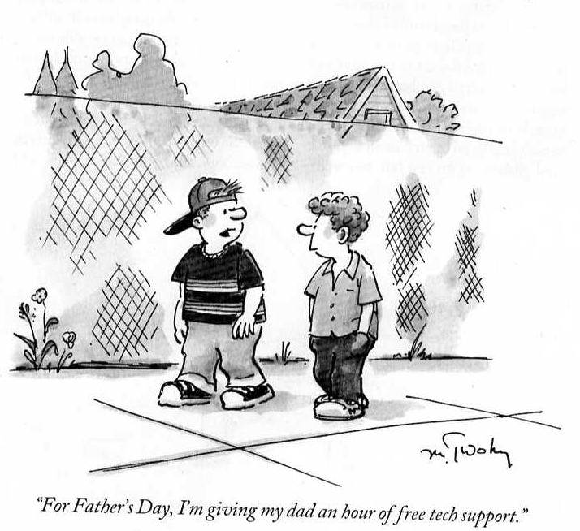

Slide 42
Your Site as Destination
Getting Found on the Web:
  Optimization – strategy has changed
  Landing Pages
  Blogs!!!
  Content Sites – Linked – but better if they link to you
  Match Content with meta data ??? Not so much
  Associate – Young Partner Committee

Slide 43
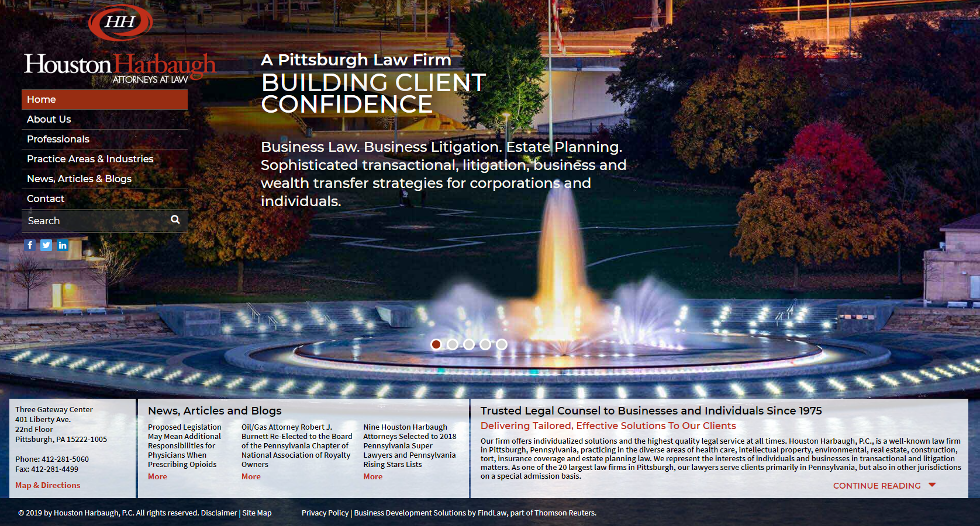

Slide 44
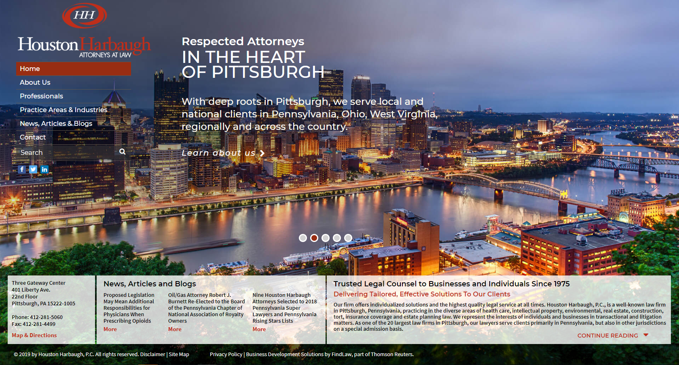

Slide 45
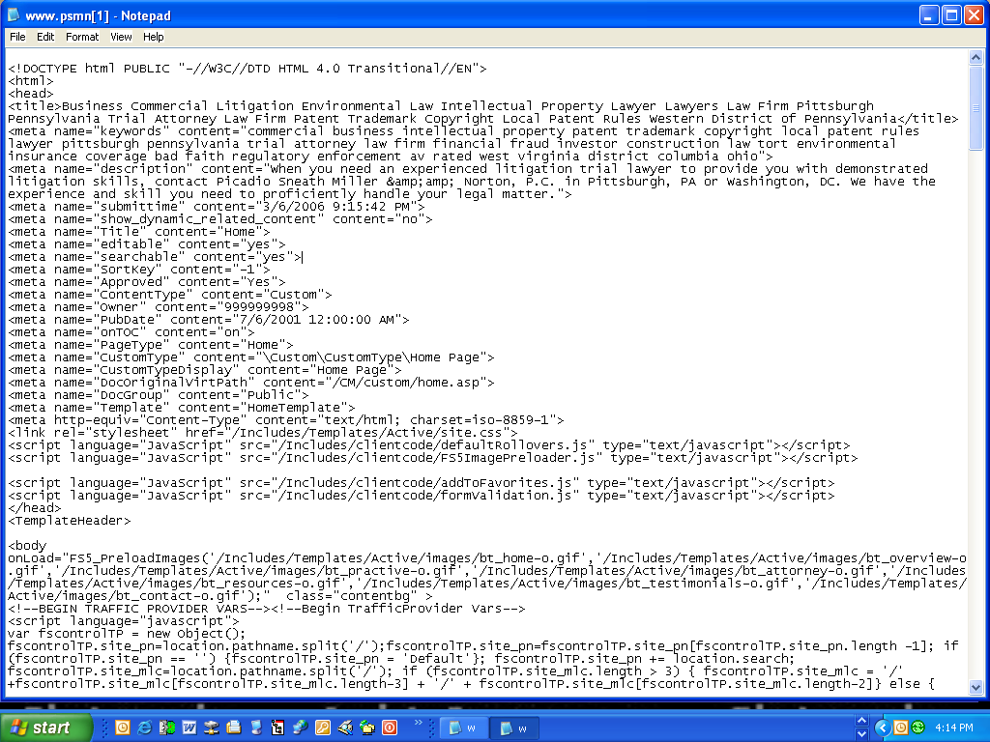

Slide 46
<title> Law Firm Houston Harbaugh, P.C. , Business Litigation. Pittsburgh Strong. </title>
<meta name ="keywords" content="commercial business intellectual property patent trademark copyright local patent rules lawyer pittsburgh pennsylvania trial attorney law firm energy financial fraud investor construction law tort environmental insurance coverage bad faith products liability regulatory enforcement av rated">
<meta name="description" content = "Well known business litigation attorneys listed in Best Lawyers in America and Pennsylvania Super Lawyers. Call us at 412-288-4000."

Slide 47
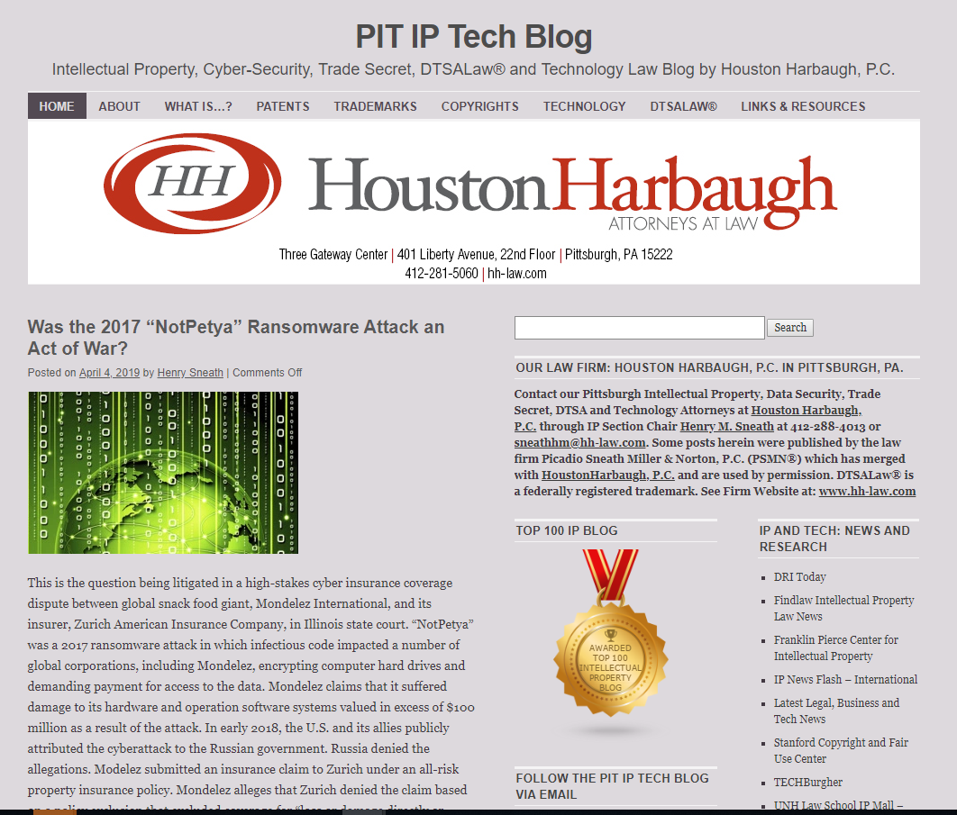
Blogs Boost Ratings

Slide 48
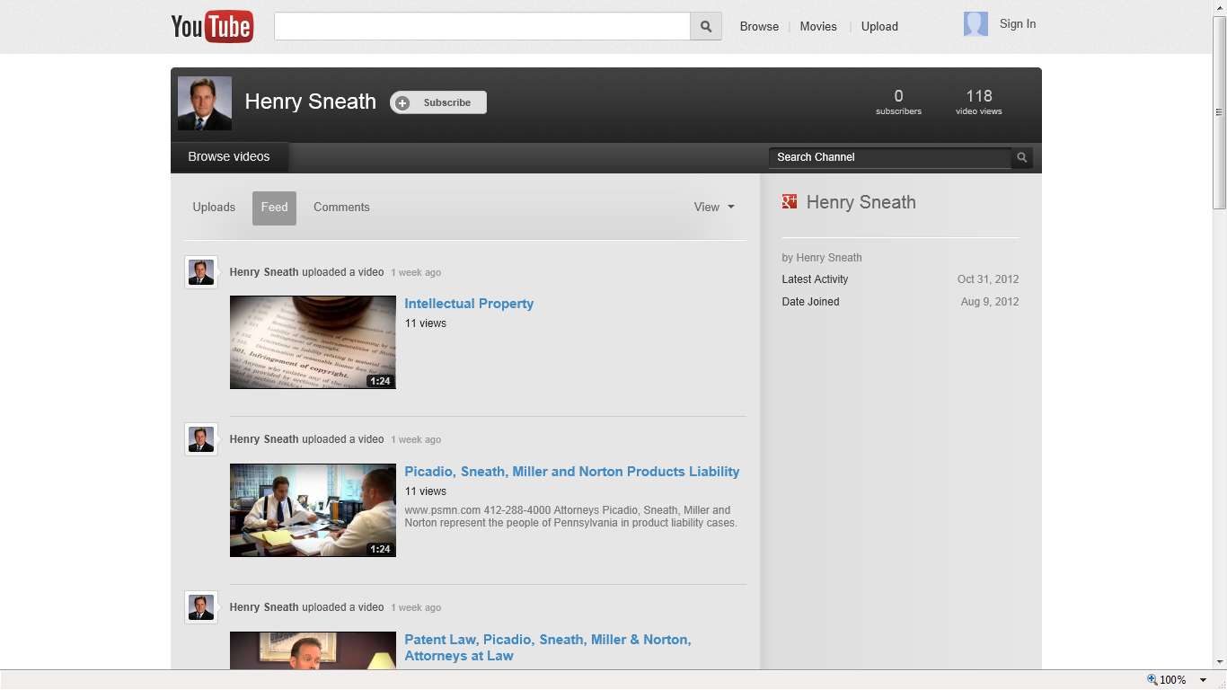
YouTube Channel

Slide 49
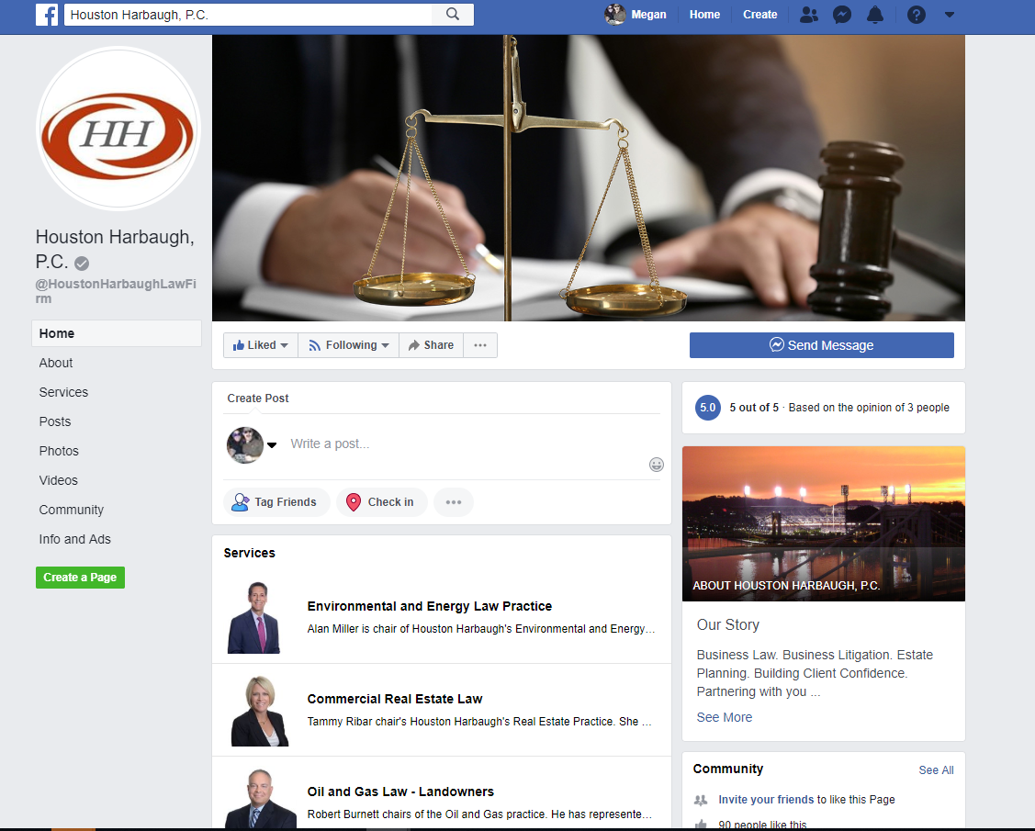
Facebook (Business and Personal)

Slide 50
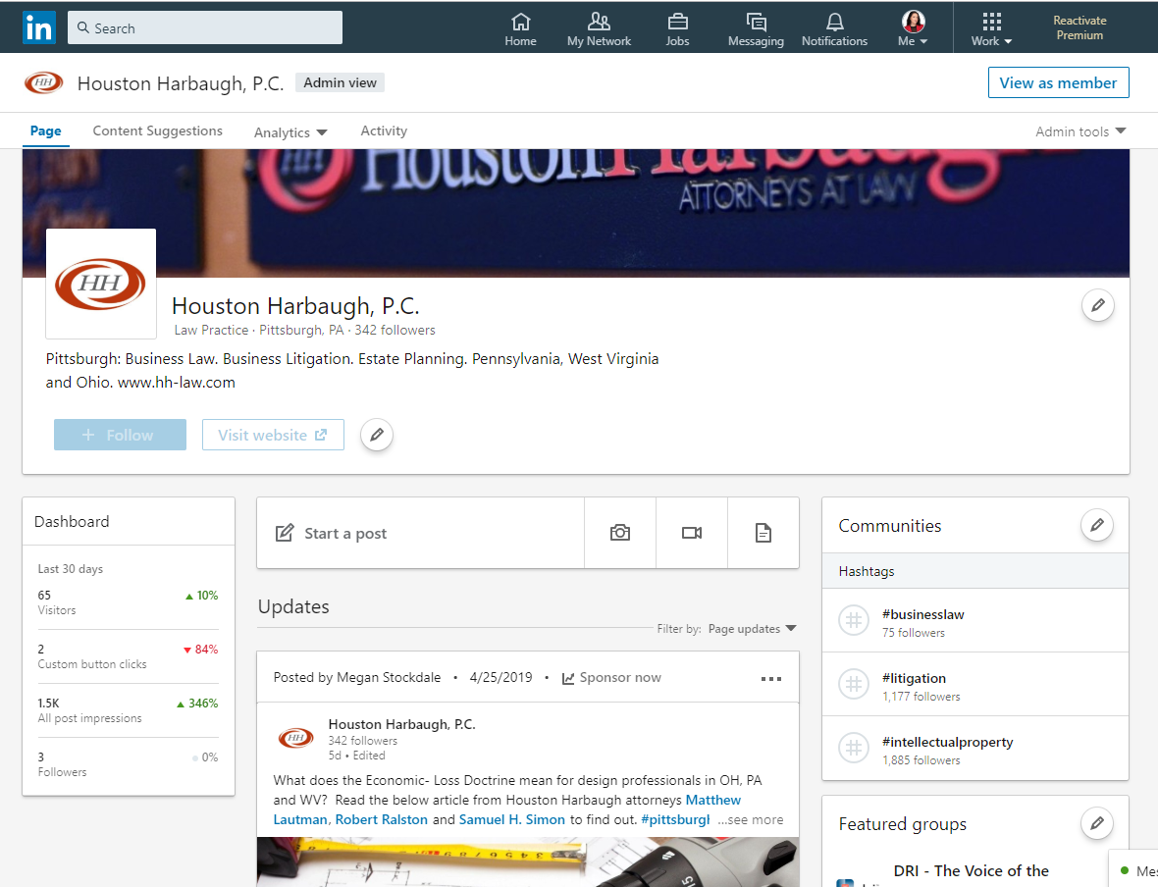
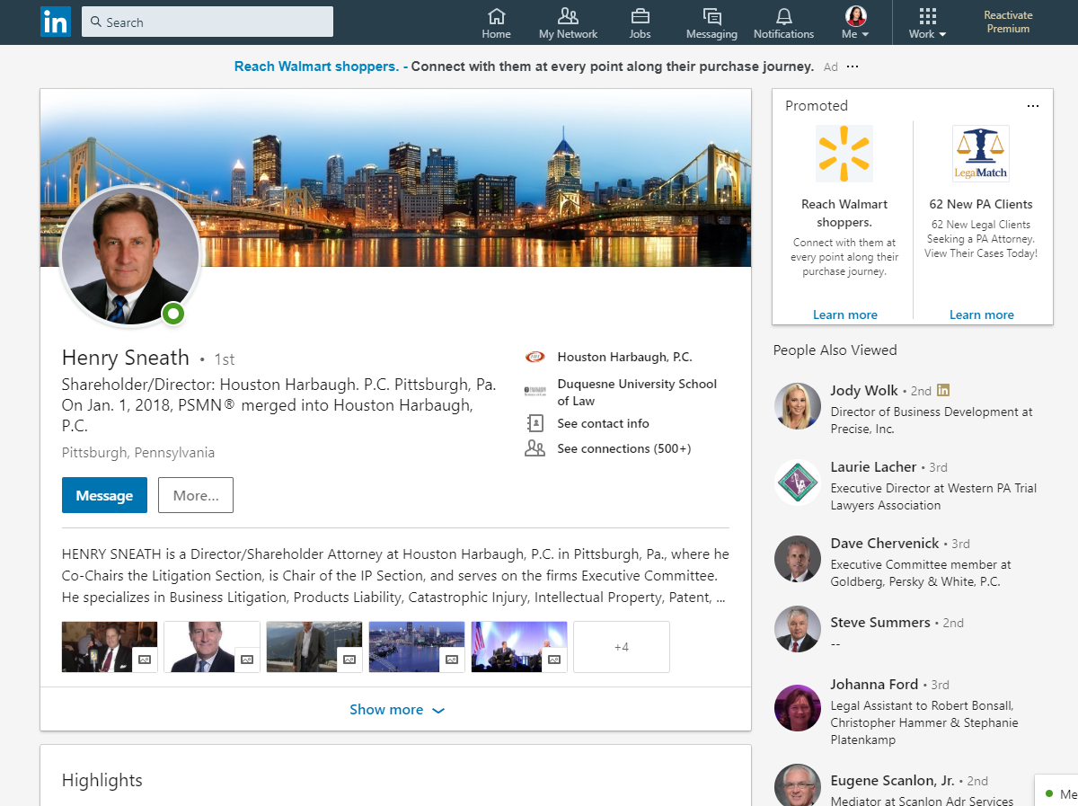
LinkedIn (Business and Personal)

Slide 51
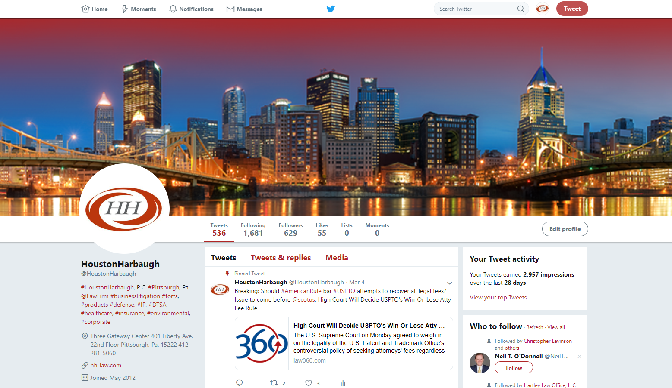
Twitter

Slide 52
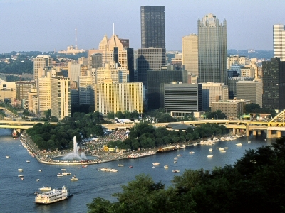
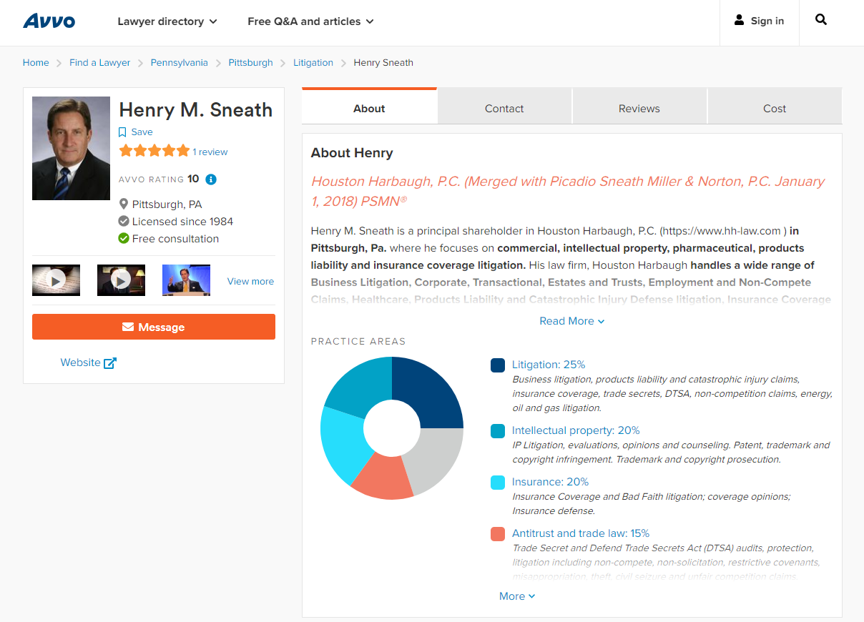
Avvo

Slide 53
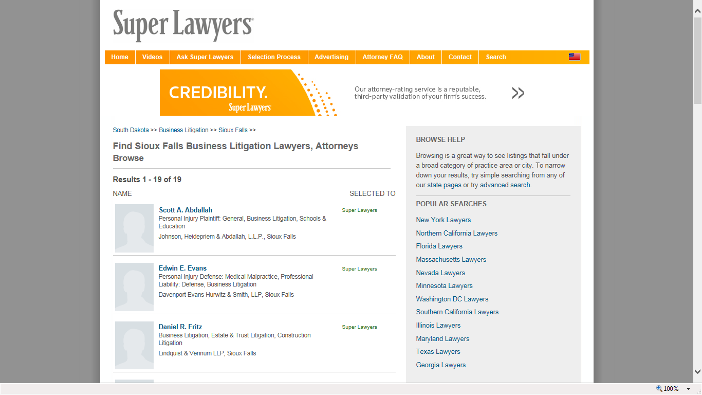
Unclaimed Spots

Slide 54
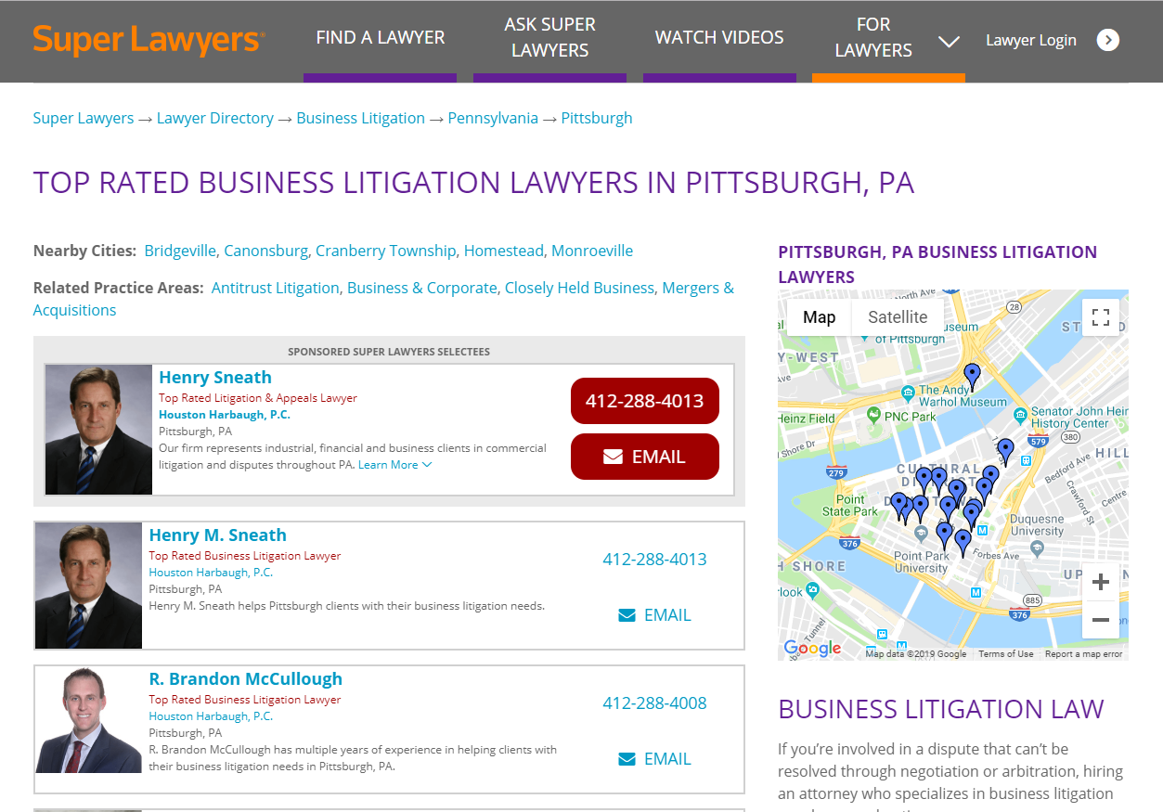
Super Lawyers Pittsburgh

Slide 55
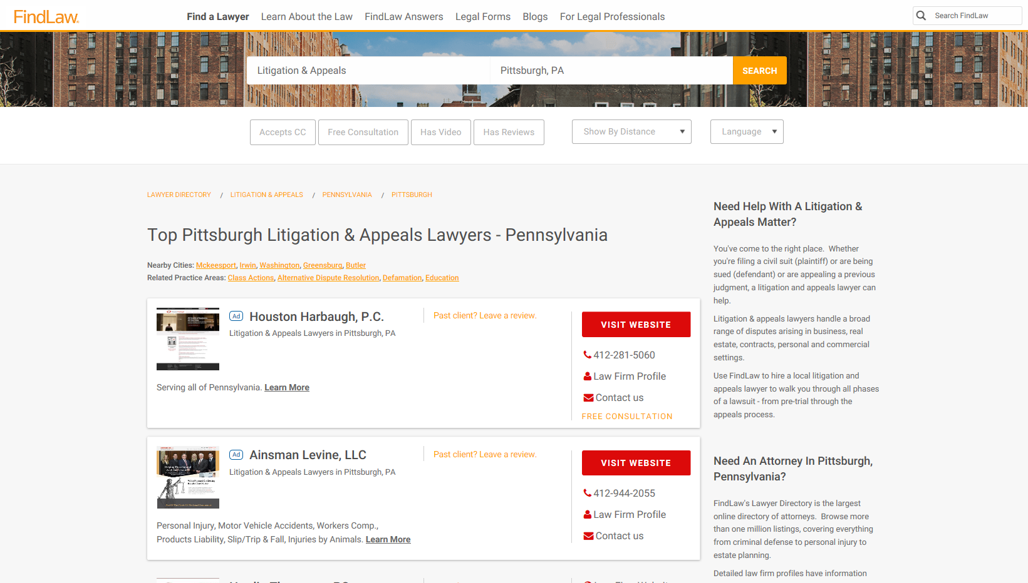
Hosting Service

Slide 56
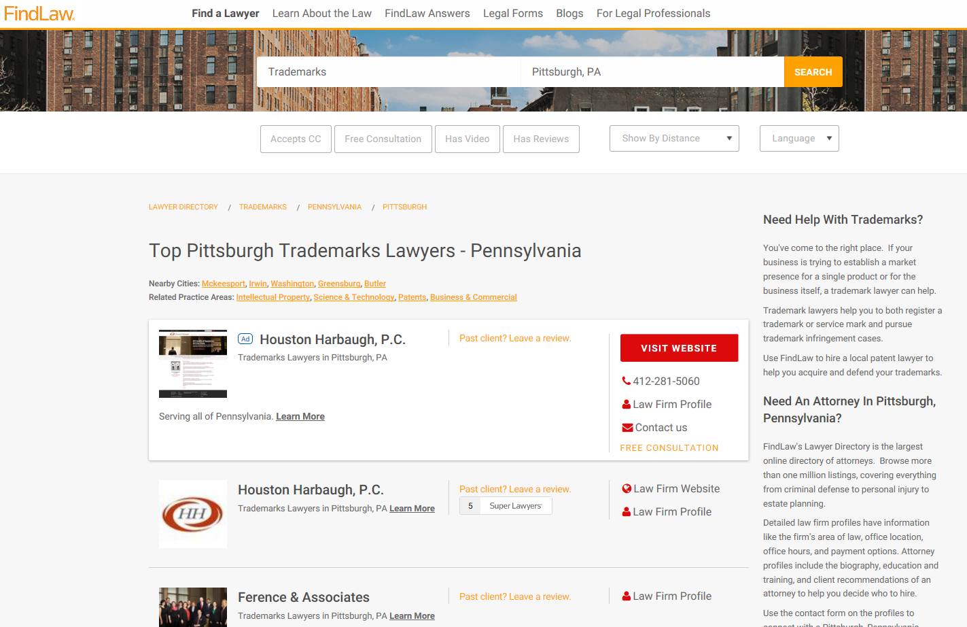

Slide 57
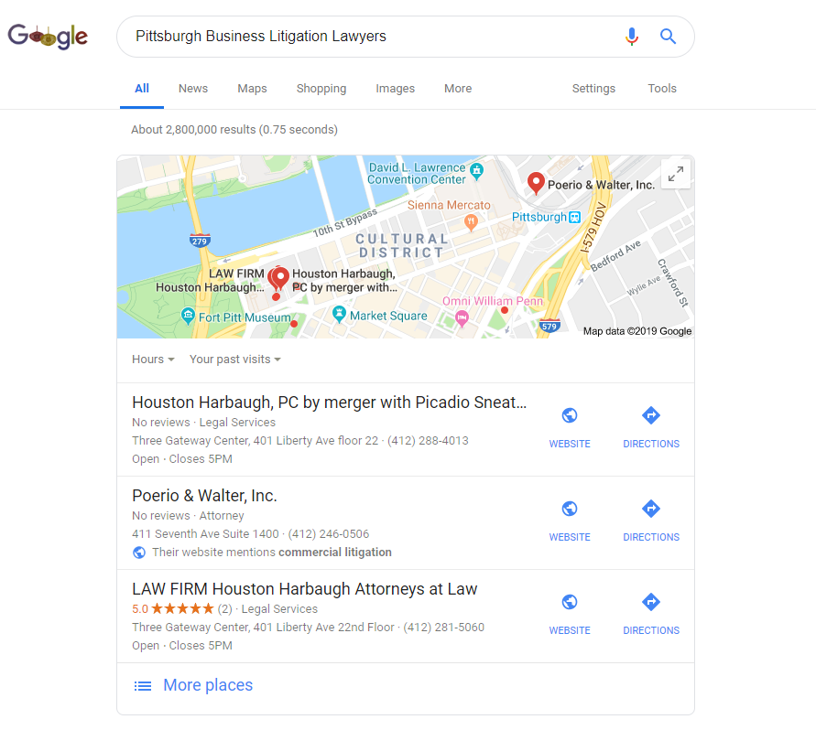
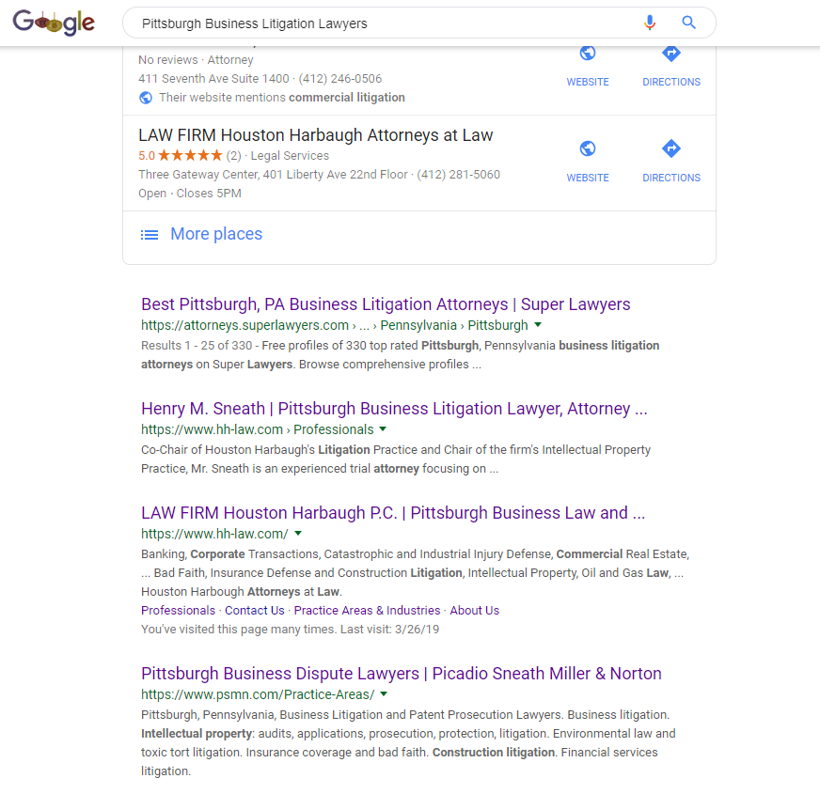
Search Term Strategy

Slide 58
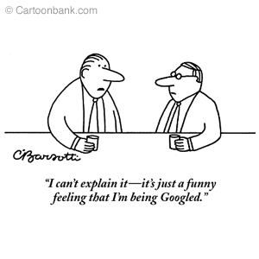

Slide 59
Tests
Goal is to be found before or after referral;
Google yourself;
Perform test searches
  Firm name
  Your name
  Keywords and phrases
  Trade and industry sites which link to firms
  Pay sites
Get traffic reports from your host

Slide 60
Other Tools
Local Counsel for commercial cases – big firms;
Attorney Referrals
Market Big Firms - Conflicts
PACER System: monitor Federal Court filings
  Insurance (110) Patent (830)

Slide 61
Profile Web Sites – Use Them
Findlaw
Martindale Hubbell
DRI Membership Directory
Super Lawyers
Best Lawyers in America
Bests Insurance Guide
Avvo.com
Center.Spoke.com
LinkedIn.com
Justia.com
Facebook
Twitter
Search “find a lawyer” and see what appears

Slide 62


Slide 63
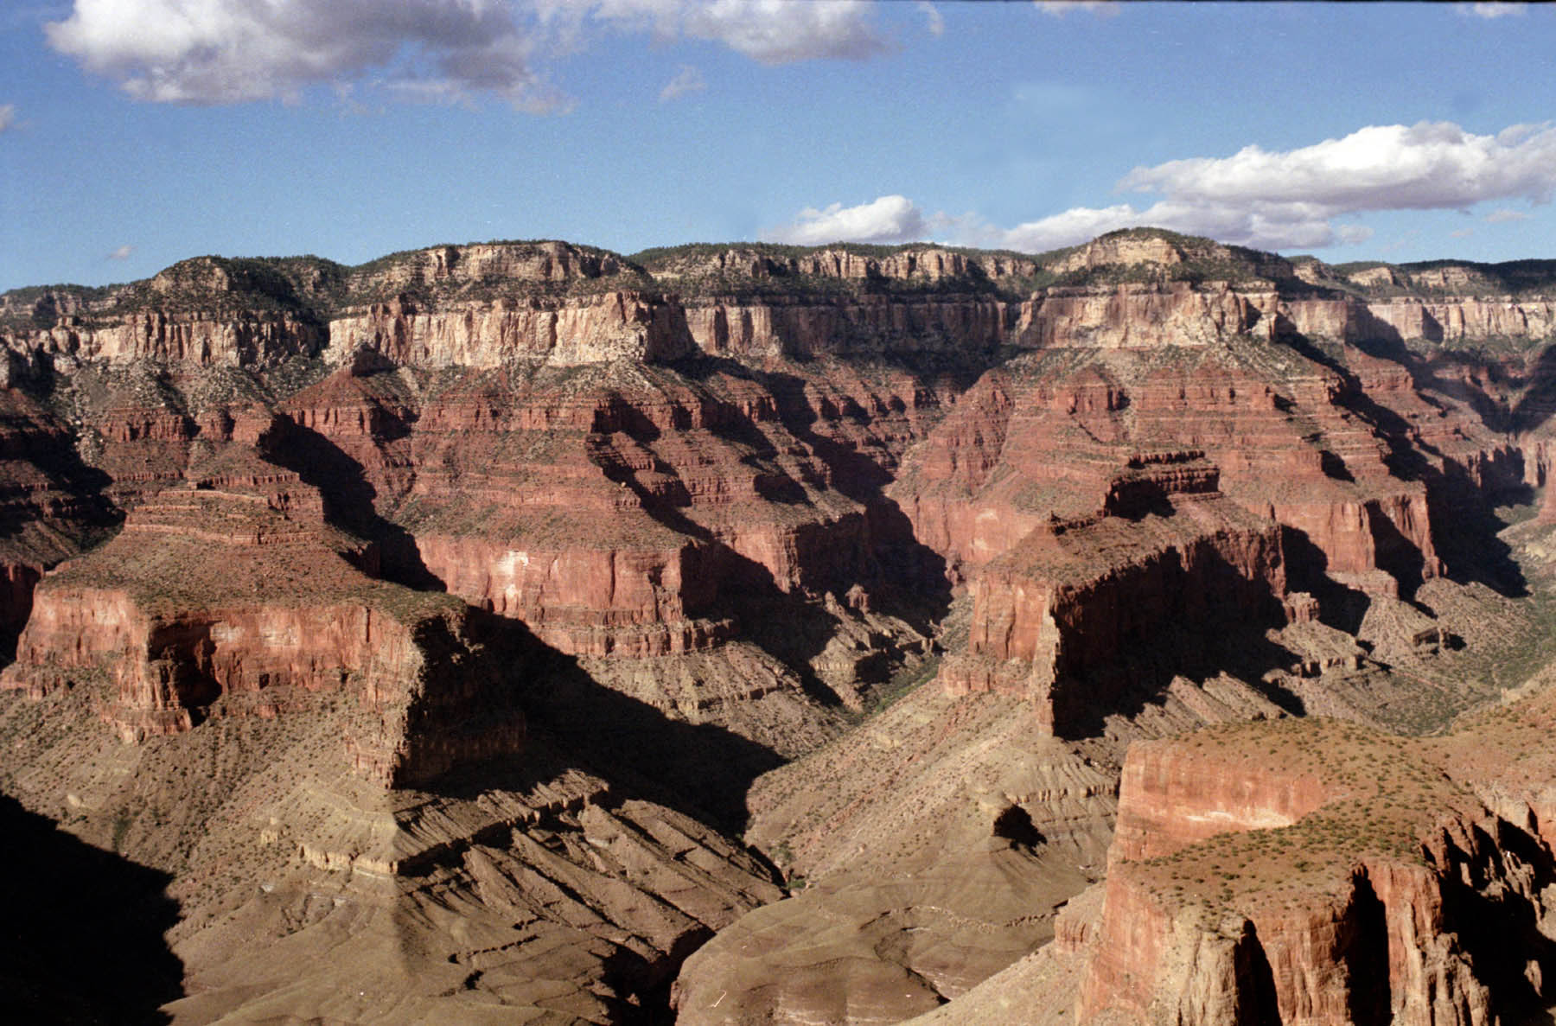
Henry M. Sneath
Picadio Sneath Miller & Norton, P.C.
Pittsburgh, Pennsylvania
412-288-4013 or www.psmn.com

